Slide 1
Predicting Customer Buying behaviour
British Airways
Imane Midoune
23/03/2025

Slide 2
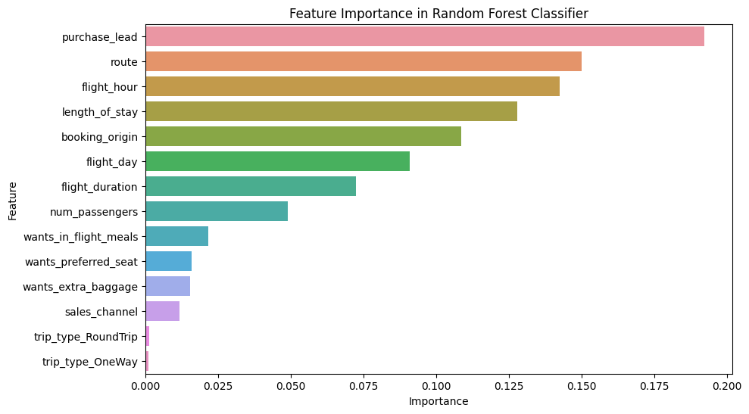
The dataset was trained using a Random Forest Classifier because it can provide valuable insights into feature importance, helping us understand which variables contribute most to the prediction.
The model achieved a cross-validated accuracy of 0.8484.
Top 5 features that influence buying behavior:
- purchase_lead.
- route.
- flight_hour.
- length_of_stay.
- booking_origin.

